Slide 1
Automatic helmet-wearing detection

Slide 2
Abstract :We propose a machine for Detection of People and Motorcyclist who are not wearing helmet. The developed application aims to help law enforcement by police, and eventually resulting in changing risk behaviours and consequently reducing the number of accidents and its severity. We present a framework for automatic detection of motorcyclists driving without helmets and people working in construction sites without helmet in surveillance videos and images. Video frames recorded by the CCTV camera and pictures taken at the scene are used to detect people who are not wearing helmet. If any person without helmet is found, then image will be capture or screen shoot will be taken and image will be stored in the database. The results show that the developed program is able to detect motorcyclists on various motorcycle types during daytime and night-time. The validation results reveal that the program achieves great accuracy in detecting the people without helmet the given stats are came up in the testing phase.

Slide 3
Existing system:
Two-wheeler is a very popular mode of transportation in almost every country. However, there is a high risk involved because of less protection. To reduce the involved risk, it is highly desirable for bike-riders to use helmet. Observing the usefulness of helmet, Governments have made it a punishable offense to ride a bike without helmet and have adopted manual strategies to catch the violators. However, the existing video surveillance based methods are passive and require significant human assistance. In general, such systems are infeasible due to involvement of humans, whose efficiency decreases over long duration . Automation of this process is highly desirable for reliable and robust monitoring of these violations as well as it also significantly reduces the amount of human resources needed. Also, many countries are adopting systems involving surveillance cameras at public places. So, the solution for detecting violators using the existing infrastructure is also cost-effective.

Slide 4
Disadvantage :
It does not considered the impact of data correlation.
It may lead to more privacy leakage than expected in industrial applications

Slide 5
Proposed system:
We present a framework for automatic detection of motorcyclists driving without helmets and people working in construction sites without helmet in surveillance videos and images. Video frames recorded by the CCTV camera and pictures taken at the scene are used to detect people who are not wearing helmet. If any person without helmet is found, then image will be capture or screen shoot will be taken and image will be stored in the database. The results show that the developed program is able to detect motorcyclists on various motorcycle types during daytime and night-time. The validation results reveal that the program achieves great accuracy in detecting the people without helmet the given stats are came up in the testing phase.
Advantages:
Proposed approach is cost effective compared to the existing system .
In proposed approach least human assistance is required.

Slide 6
Libraries :
Pandas: pandas is an open source, BSD-licensed library providing high-performance, easy-to-use data structures and data analysis tools for the Python programming language.
Numpy: NumPy is a general-purpose array-processing package. It provides a high-performance multidimensional array object, and tools for working with these arrays. It is the fundamental package for scientific computing with Python.
MatPlotLib: matplotlib.pyplot is a plotting library used for 2D graphics in python programming language. It can be used in python scripts, shell, web application servers and other graphical user interface toolkits
Scikit-learn: Scikit-learn is a free machine learning library for Python. It features various algorithms like support vector machine, random forests, and k-neighbors, and it also supports Python numerical and scientific libraries like NumPy and SciPy.

Slide 7
SYSTEM SPECIFICATIONS
SOFTWARE REQUIREMENTS:
OS : Windows
Python IDE : python 2.7.x and above
Pycharm IDE,
Anaconda 3.5
Setup tools and pip to be installed for 3.6.x and above .
HARDWARE REQUIREMENTS:
RAM : 4GB and Higher
Processor : Intel i3 and above
Hard Disk : 500GB: Minimum

Slide 8
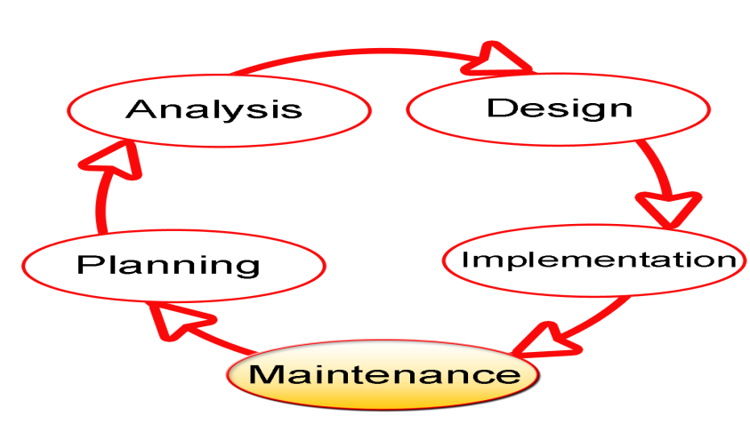
SDLC Methodologies
The Software Development Lifecycle (SDLC) for small to medium database application development efforts.
This project uses iterative development lifecycle, where components of the application are developed through a series of tight iteration. The first iteration focus on very basic functionality, with subsequent iterations adding new functionality to the previous work and or correcting errors identified for the components in production.

Slide 9
The six stages of the SDLC are designed to build on one another, taking outputs from the previous stage, adding additional effort, and producing results that leverage the previous effort and are directly traceable to the previous stages. During each stage, additional information is gathered or developed, combined with the inputs, and used to produce the stage deliverables. It is important to not that the additional information is restricted in scope, new ideas that would take the project in directions not anticipated by the initial set of high-level requirements or features that are out-of-scope are preserved for later consideration.

Slide 10
UML Diagrams

Slide 11
Use Case :

Slide 12
Sequence Diagram:

Slide 13
Collaboration Diagram:

Slide 14
User Activity Diagram :

Slide 15
Class Diagram:

Slide 16
Component Diagram:
dataset
server
modules
algorithms

Slide 17
State Diagram:

Slide 18
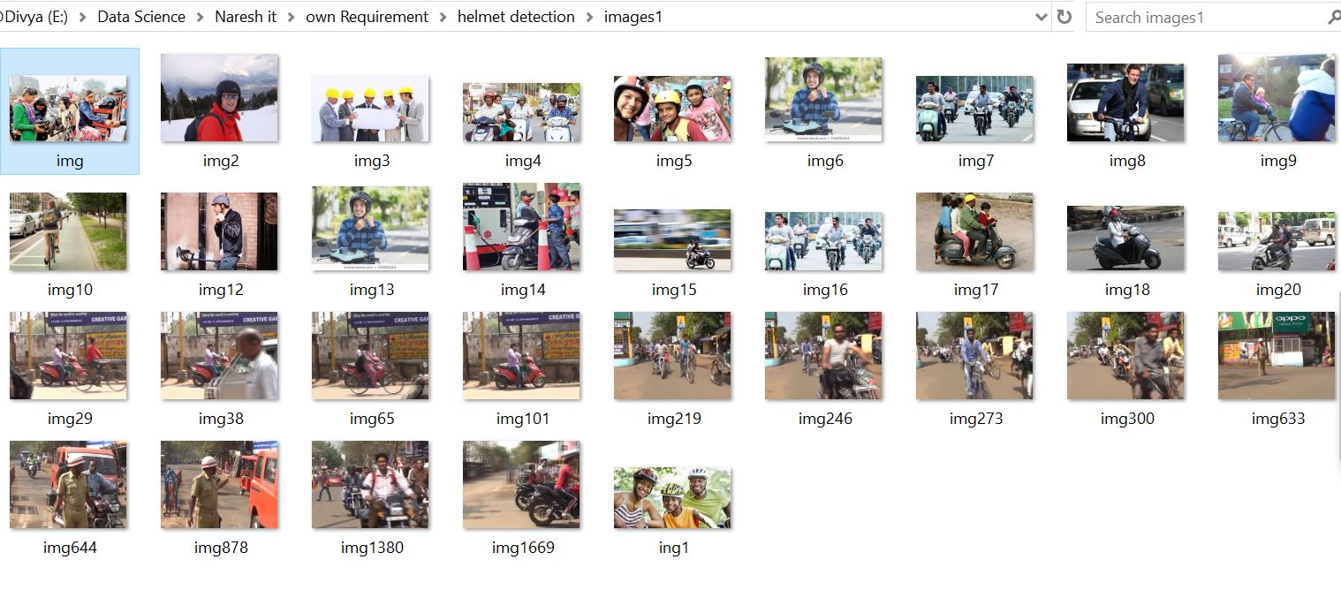

Slide 19
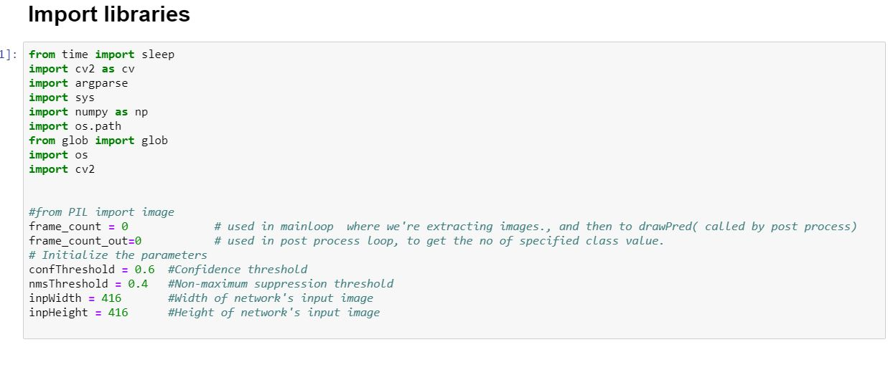

Slide 20
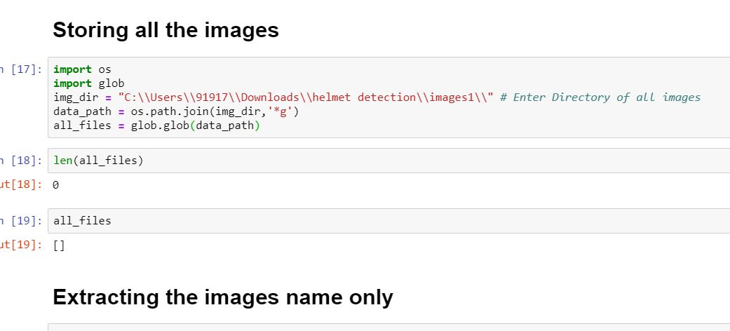

Slide 21
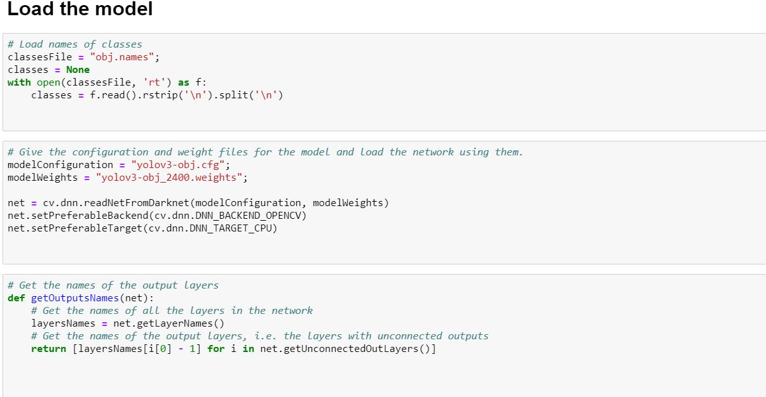

Slide 22
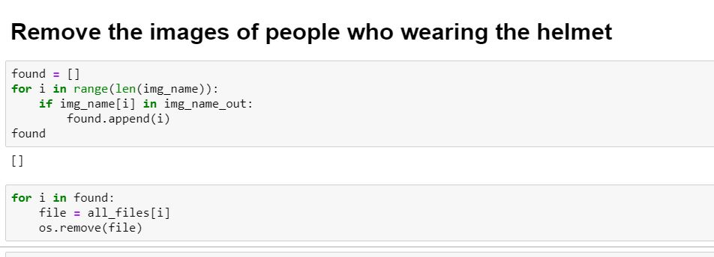

Slide 23
